Slide 1
Secure Data Hiding in Image Using Steganography
CAPSTONE PROJECT
Presented By:
Student Name : Manoj Kumar C
College Name & Department : Sri Sairam Engineering College
Electrical and Electronics Engg.

Slide 2
OUTLINE
Problem Statement
Technology used
Wow factor
End users
Result
Conclusion
Git-hub Link
Future scope

Slide 3
Problem Statement
Data security is vital in digital communication, and encryption, while effective, can attract unwanted attention. Steganography hides secret messages within images, making the data transmission undetectable. This project implements an image-based steganographic technique by modifying pixel values to embed text securely. It ensures covert communication while maintaining the image’s visual integrity.

Slide 4
Technology used
Programming Language:
Python – Used for scripting, image processing, and implementing steganographic algorithms.
Libraries & Modules:
OpenCV (cv2) – Used for image loading, manipulation, and saving operations.
OS Module (os) – Handles file system operations and platform-specific commands.
Platform & Environment:
Operating System: Works on both Windows & Linux with minimal modifications.
Development Environment: The project was implemented and tested VS Code.
Methodology:
The steganographic process involves:
Least Significant Bit (LSB) Modification: Secret data is embedded by altering the lowest bit of pixel values in the image.
Pixel-Based Encoding: Each character of the message is mapped to a pixel value.
Password-Based Access Control: Ensures only authorized users can retrieve the hidden message.

Slide 5
Wow factors
This project introduces several enhancements to conventional steganography:
Invisible Data Storage: The pixel modifications are undetectable to the human eye.
Password Protection: Ensures only authorized users can access hidden messages.
Minimal Image Distortion: Optimized pixel changes preserve image quality.
Cross-Platform Compatibility: Works seamlessly on Windows & Linux.
User-Friendly Interface: Simple menu-driven console application for easy usage.

Slide 6
End users
Government & Intelligence Agencies
Journalists & Whistleblowers
Corporates & Businesses
General Users

Slide 7
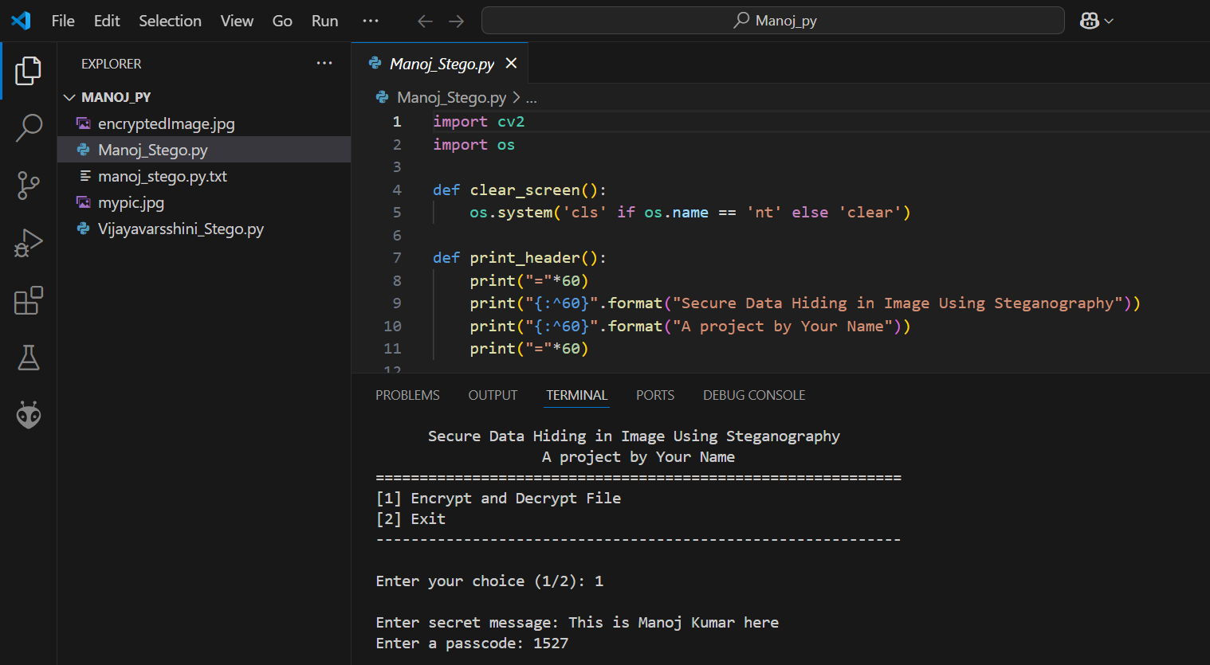
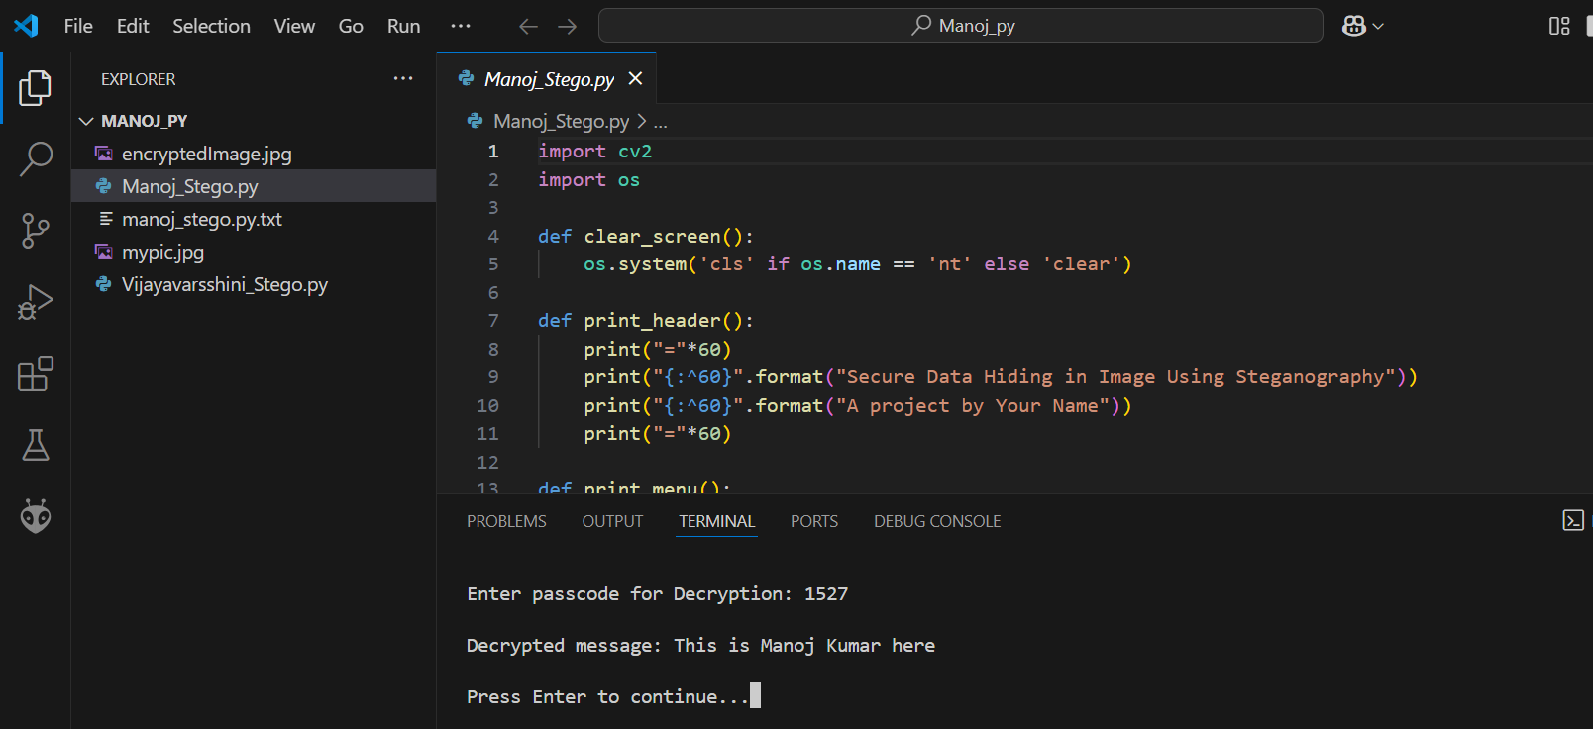
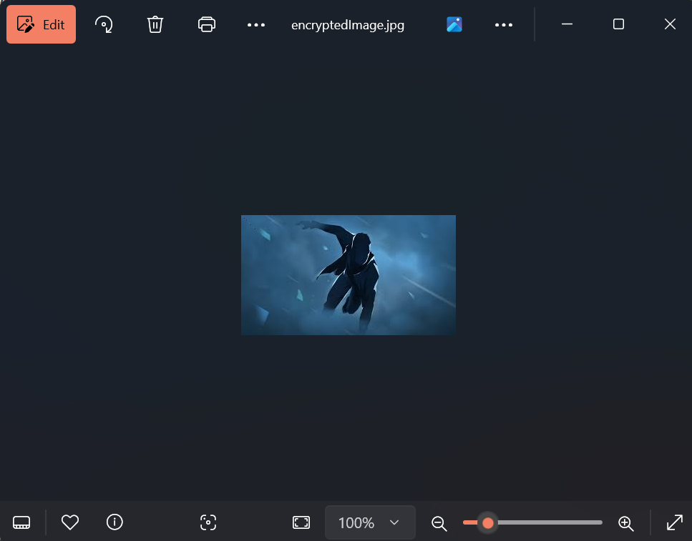
Results
Encryption Process
Decryption Process
Encrypted Image File

Slide 8
Conclusion
The image-based steganographic system developed in this project demonstrates secure and efficient data hiding using Python and OpenCV. The LSB technique ensures imperceptible modifications to the image, while password protection enhances security. This project provides a practical and scalable solution for private communication, intelligence operations, and cybersecurity applications.

Slide 9
GitHub Link
https://github.com/Mano-15/AICTE-Project---Manoj-Kumar-C.git

Slide 10
Future scope
Potential enhancements for future improvements include:
Advanced Encryption Integration: Combining AES/RSA encryption with steganography for added security.
Multi-Format Support: Extending compatibility to PNG, BMP, GIF formats.
Higher Capacity Encoding: Optimizing data encoding to store larger messages.
Mobile App Development: Implementing a user-friendly Android/iOS version.
Anti-Steganalysis Measures: Enhancing algorithms to resist detection tools used in forensic analysis.

Slide 11
THANK YOU

